Slide 1
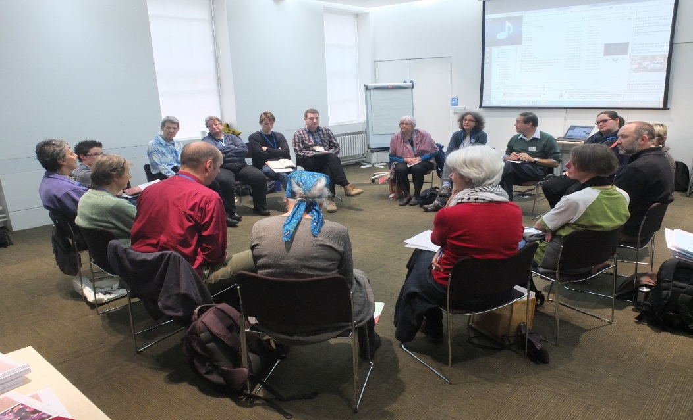
What was it like to read Quaker faith & practice?
We appreciated the opportunity to read Quaker faith & practice.

Slide 2
What was it like to read Quaker faith & practice?
We have delved into enriching and thought provoking extracts.

Slide 3
What was it like to read Quaker faith & practice?
Reading the whole book has inspired me: I feel more like a Quaker.

Slide 4
What was it like to read Quaker faith & practice?
It requires a high level of literacy.

Slide 5
What was it like to read Quaker faith & practice?
The book is a treasure trove of Quaker insights.

Slide 6
What was it like to read Quaker faith & practice?
By the end we knew more about the range of beliefs within our meeting.

Slide 7
What was it like to read Quaker faith & practice?
We noted how difficult it is for a printed book to keep up with changes – in society and in our own church government.

Slide 8
What was it like to read Quaker faith & practice?
We have begun to ask what the book is for.

Slide 9
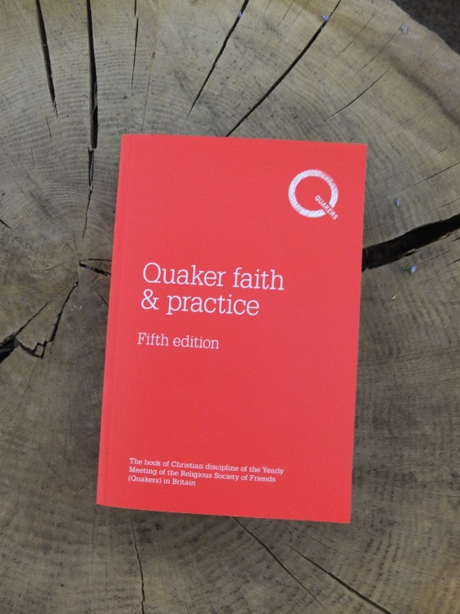
Our “red book": what is it and what do we love about it?
It links Friends as a community across miles and generations.

Slide 10
Our “red book": what is it and what do we love about it?
It is partly a manual for Quaker life and partly a reference book.

Slide 11
Our “red book": what is it and what do we love about it?
A thousand wonderful things!

Slide 12
Our “red book": what is it and what do we love about it?
It is best approached as poetry.

Slide 13
Our “red book": what is it and what do we love about it?
It holds a mirror up for us.

Slide 14
Our “red book": what is it and what do we love about it?
Answers to questions of right ordering are there to be found.

Slide 15
Our “red book": what is it and what do we love about it?
There is power in the immediacy and directness of the writings of early Friends, despite sometimes unfamiliar language.

Slide 16
Our “red book": what is it and what do we love about it?
It contains the roots, trunk and branches of our faith.

Slide 17
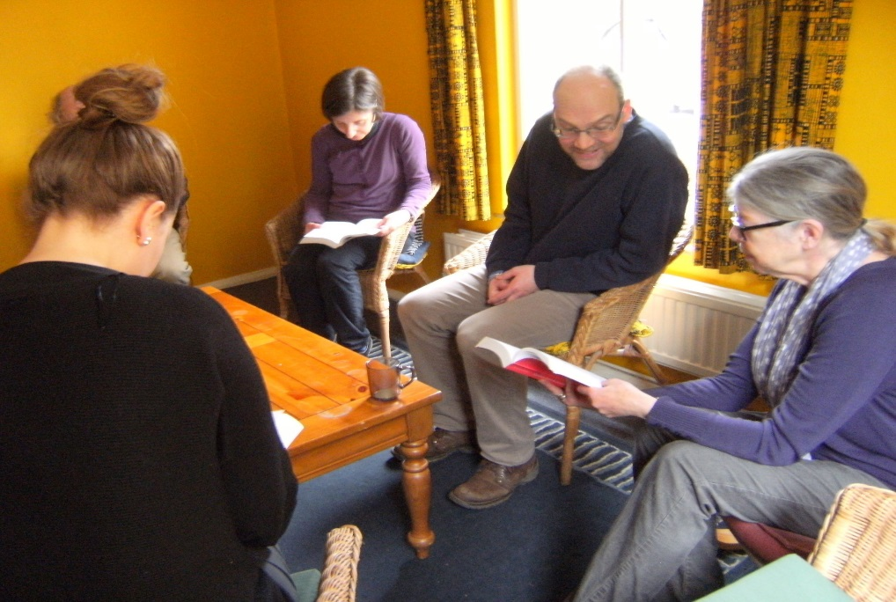
What do we want from our Book of Discipline?
To help each other maintain our faith in the complex modern world.

Slide 18
What do we want from our Book of Discipline?
To feel both challenged and upheld.

Slide 19
What do we want from our Book of Discipline?
To rediscover our focus, purpose and discipline.

Slide 20
What do we want from our Book of Discipline?
The sense of ongoing revelation is a distinctive feature of our tradition, and our book of discipline should reflect this.

Slide 21
What do we want from our Book of Discipline?
Let’s give our young people the seeds for the future.

Slide 22
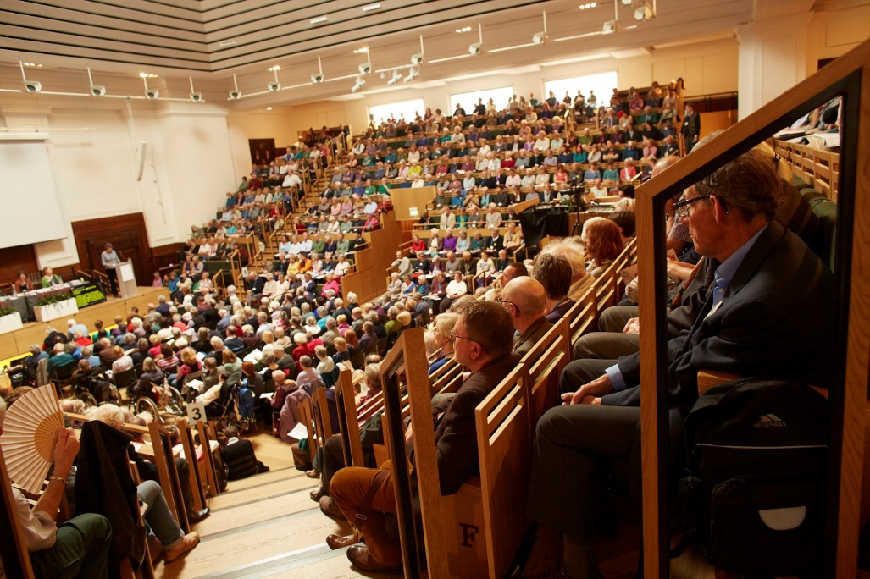
What should Friends remember if we go forward to revision?
We have moved on, and so has the world.

Slide 23
What should Friends remember if we go forward to revision?
Faith can be a process rather than a set of fixed tenets.

Slide 24
What should Friends remember if we go forward to revision?
It’s hard to know where you are unless you know where you have come from.

Slide 25
What should Friends remember if we go forward to revision?
Leadings of the Spirit are strongly framed by the culture and times in which we live.

Slide 26
What should Friends remember if we go forward to revision?
Concerns should lead to positive action. “Faith IN practice”. “Faith IS practice.”

Slide 27
What should Friends remember if we go forward to revision?
The voice of young people is essential – it will be their book.

Slide 28
What should Friends remember if we go forward to revision?
Words do not need to divide us. In the silence is where we understand each other.

