Slide 1
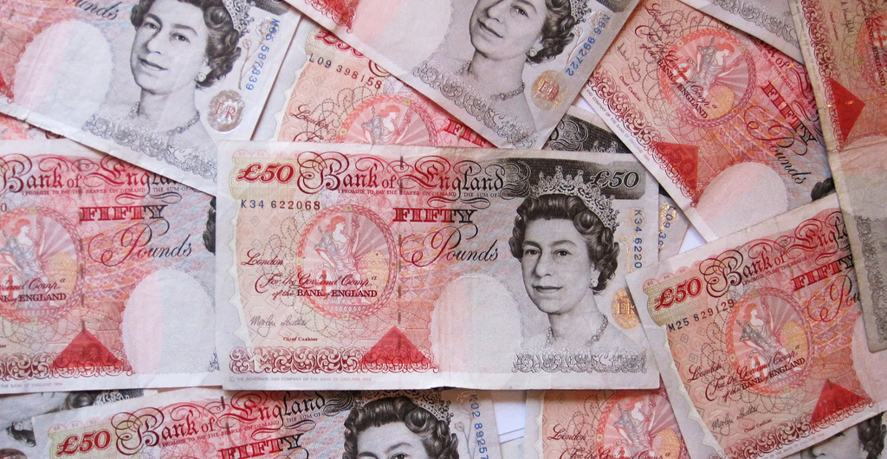
Budget for a safer world
How would you spend £45,000,000,000 to make the world safer?
In this assembly, you will decide.
A pile of 50 pound notes by Images Money via Flickr https://www.flickr.com/photos/59937401@N07/5474155241/in/photolist-9kJtCV-8pup2p-cSKvfU-6SKbGu-aXTBnX-8pupSi-9kP6MU-9kJuve-a31WN9-9kMMvL-6mTeY9-8KL9Ff-6SKbxo-gfgyLd-qSVCq4-qEw1kK-kdsbzK-9VMgvz-9VAmAB-8PY4BV-nox1UK-yqVyYs-4icUAV-gNDKEw-g94mvD-472wmB-oPTnLV-9VzCaq-ijY8gT-CfKk8R-9BDELm-5eD1KB-tsGXem-5mbc1H-69hd1g-xchm6-4ohhPn-diomHS-dQUfrx-ru8N8R-9YonaS-bYfzb5-5rjH75-6kRjvB-4kA75h-9VC9zS-vqoNF-hwzgqu-7RE6oi-iQE4JN/

Slide 2
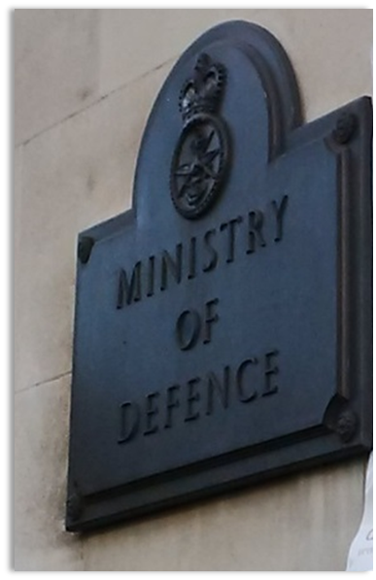
Two points of view

Slide 3
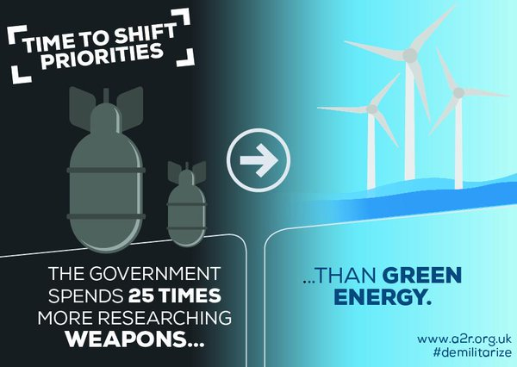
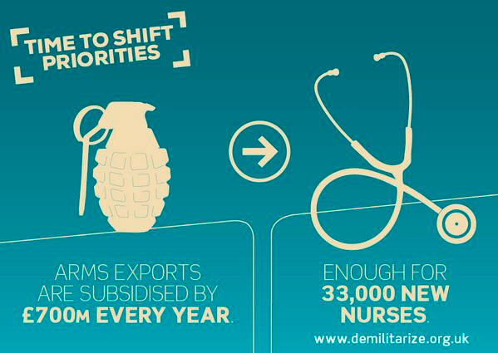
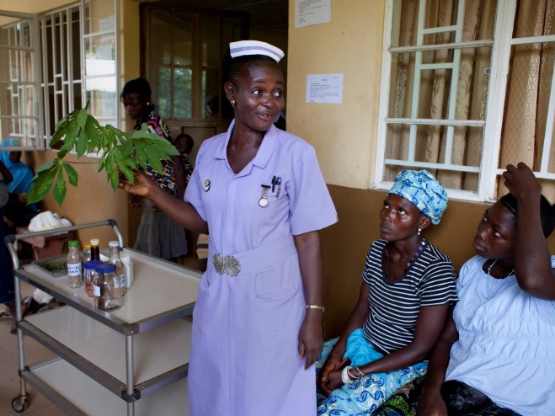
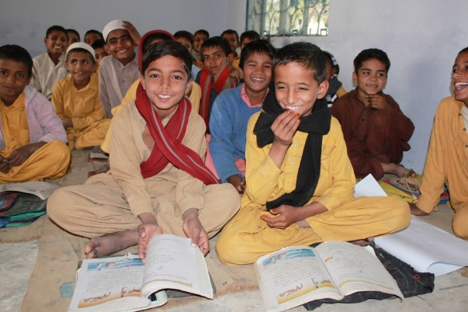
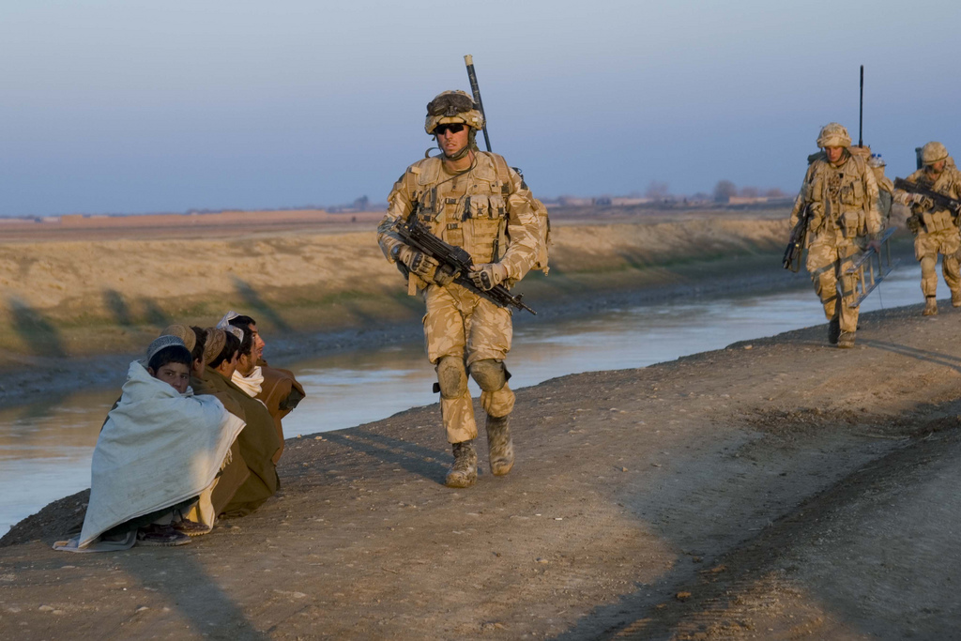
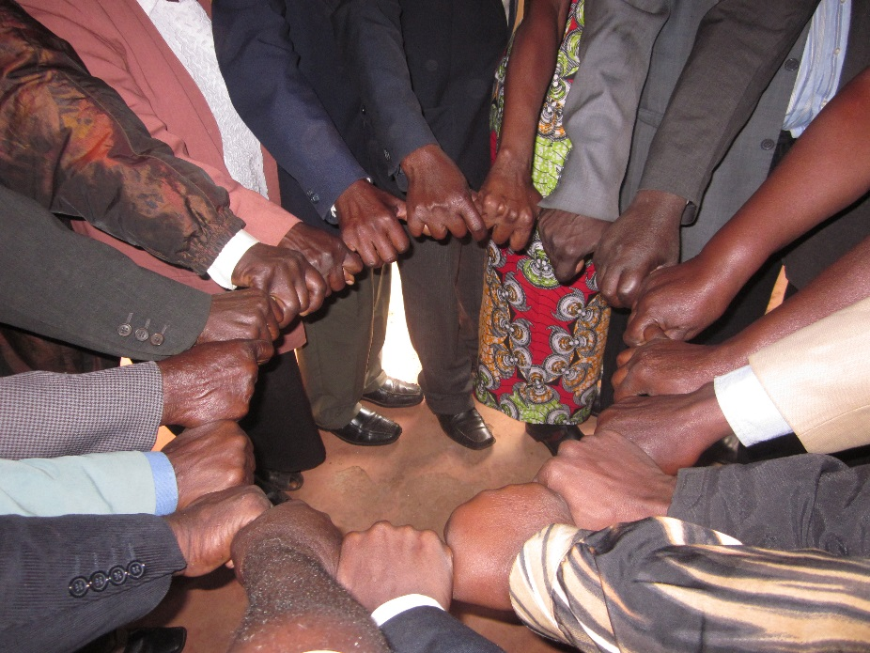
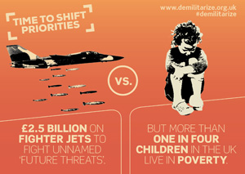
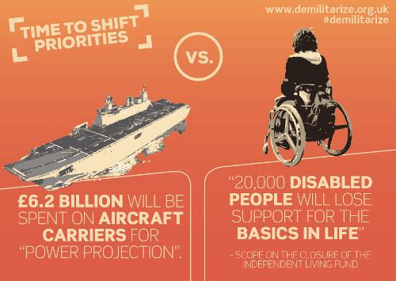
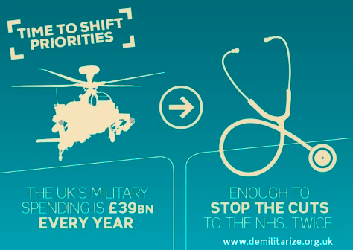
Click on an image to zoom and get more information
Next

Slide 4
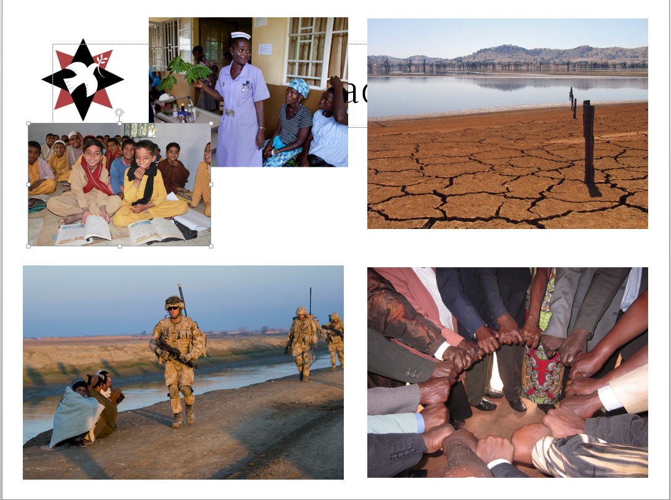
Sending the military overseas as in Iraq, Afghanistan and Libya
The war in Afghanistan had cost the UK £25-37 billion by 2013
Building and selling more weapons to other countries
Recruiting people into the armed forces
Keeping “Trident” nuclear weapons on submarines
Arms and military
intervention
Image of British troops in Afghanistan from ResoluteSupportMedia
BACK
Notes:
More information about the cost of the Afghanistan War : http://www.theguardian.com/world/2013/may/30/afghanistan-war-cost-britain-37bn-book

Slide 5
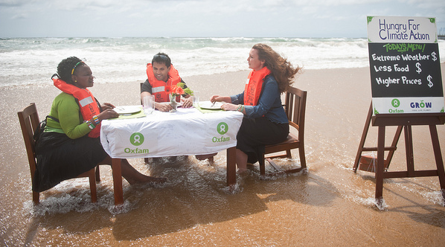
Finding new sources of energy
Investing in technologies that protect the planet and its people
Help people suffering because of drought and flooding
Oxfam believes £518bn could be needed to help people survive in poor countries before 2050
Tackling climate change
Oxfam hungry for climate action at Durban Climate Conference via Flickr
Tim J Keegan took this shot of a lake in Australia at just 4% of its original depth via Flickr.
BACK
Notes:
More information from Oxfam’s 2015 report: http://www.oxfam.org.uk/media-centre/press-releases/2015/11/delays-in-cutting-emissions-set-to-cost-developing-countries-hundreds-of-billions-of-dollars-more

Slide 6
Diplomacy- getting governments and leaders talking, not fighting
Conflict prevention- working with people to find solutions before things get too hot!
Training peacemakers-people who know how to use nonviolence to change things for the better
Peacebuilding
BACK
Grassroots peacebuilding work in Western Kenya- photo from Quaker Peace & Social Witness

Slide 7
Building hospitals and train nurses and doctors so people are safer from injury and disease
Help people to earn a living so they can look after themselves
Invest in education so people learn about the world around them
Health
This photo from the H4+ Partnership shows a student midwife in a hospital in Sierra Leone
Education
This photo from DFID of a school in Pakistan
Next
BACK

Slide 8
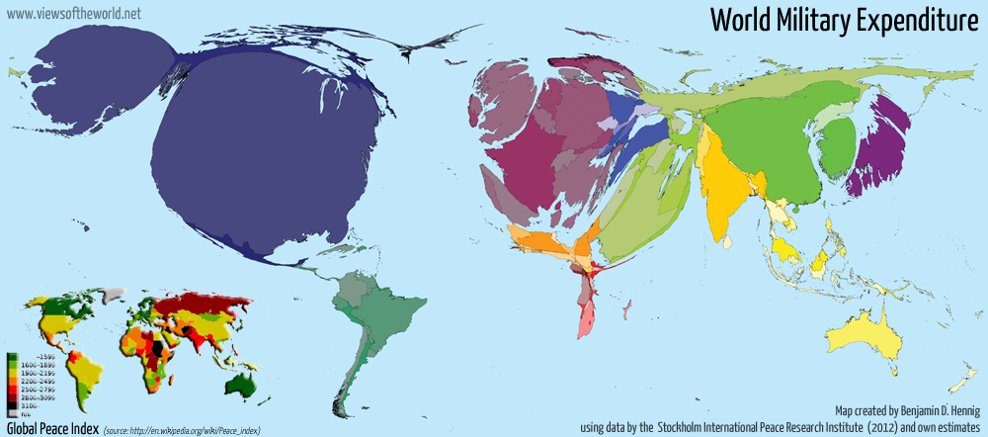
Global military spending
The World spends $1.7 trillion dollars on the military.
That’s $1,700,000,000,000
The United Kingdom is ranked the sixth biggest spender
Notes:
This strange looking map alters the size of countries based on how much they spend on the military- the higher the military spending the bigger the country
Can you see the UK? What do you notice about it? What other countries do you recognise?
More information about this map can be found at: http://www.viewsoftheworld.net/?p=3363
https://www.youtube.com/watch?v=MBGeBlsiSMU

Slide 9
Let’s vote

Slide 10
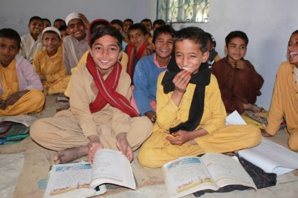
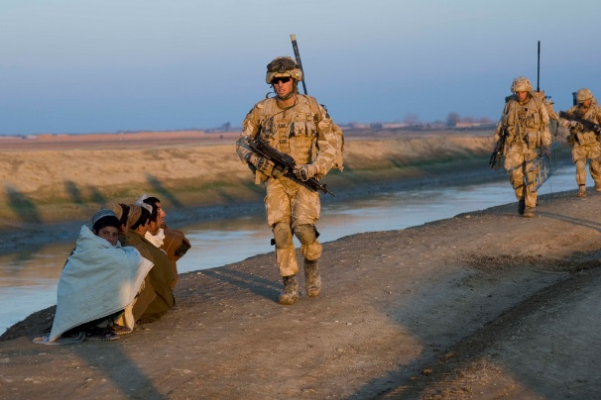
Results
To update the chart, leave presentation mode, right click the pie chart and select “edit data” (or you can use the Excel Spreadsheet)
Share online
Notes:
Go to http://bit.ly/GDAMS-Submit-2016 to add your results to the national survey

