Slide 1
Your faith, your finance A workshop from Quaker Peace & Social Witness
Notes:
Why money?
Whether we’ve got a little or a lot, almost all of us have to make decisions about money – what we spend it on, what we give to, what we do with it when we’re not using it.
We have to make those decisions personally and as meetings.
These decisions can say a lot about our values, and have a potentially significant impact on the world around us.
The potential for making informed, ethical, decisions about money is increasing at a rapid rate.
What are the aims of the workshop?
To help participants explore how the way we use our money connects to our Faith.
To leave participants with a sense of the range of options that are available to them as individuals and as a meeting.
It is worth acknowledging here the fact that talking about money can be difficult, and that we should respect that. No one should feel the need to share more than they feel comfortable with.
Also, make it clear that the workshop is intended to help meetings explore the ethical issues surrounding their finances, which is a useful first step, but individuals and meetings may also need to seek professional advice.

Slide 2
Why link faith and finance?
“We need to ask the question whether this system is so broken that we must urgently work with others of faith and good will to put in its place a different system in which our testimonies can flourish.”
Minute 23, Britain Yearly Meeting 2011
“The action we are ready to take at this time is to make a strong corporate commitment to become a low-carbon, sustainable community.”
Minute 36, Britain Yearly Meeting 2011
Notes:
Why link faith and finance?
For many Friends this won’t be new. Quaker Faith and Practice has plenty of references to what a Quakerly approach to the use of money might look like. Friends have a long tradition of being conscious of the impact of our money.
Britain Yearly Meeting has recently made a commitment to become a low carbon, sustainable community and to work towards creating an economic system in which our Quaker testimonies can flourish. Minutes 23 and 36 from BYM in 2011 highlight this commitment. The way we use our money can be a tool to help us bring about these changes, yet if we fail to take an active interest in how our money is managed and used, we run the risk of it undermining our testimonies and values.
QPSW set up the Your Faith, Your Finance project as a response to queries from Friends saying that they knew there was a connection between their own financial resources and these minutes, but they didn’t know where to start thinking about it. For others there will be other reasons as to why they want to think about these issues.
You might also know that for many years, QPSW has worked through the Ecumenical Council for Corporate Responsibility to use Churches’ money as a lever to challenge poor social and environmental performance on the part of large companies.

Slide 3
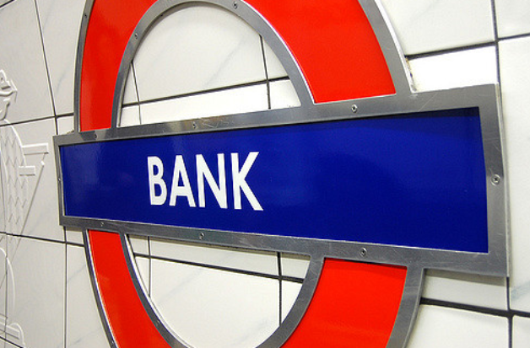
Where is our money?
Photo credit: Yaili (Flickr,CC 2.0)
Notes:
Where is our money?
Ask the group to spend a few minutes thinking about money and financial resources.
Some suggestions include:
Banking arrangements
Pensions
Savings
Investment products (e.g. ISAs)
Property
Possessions (normally items that accrue over time).

Slide 4
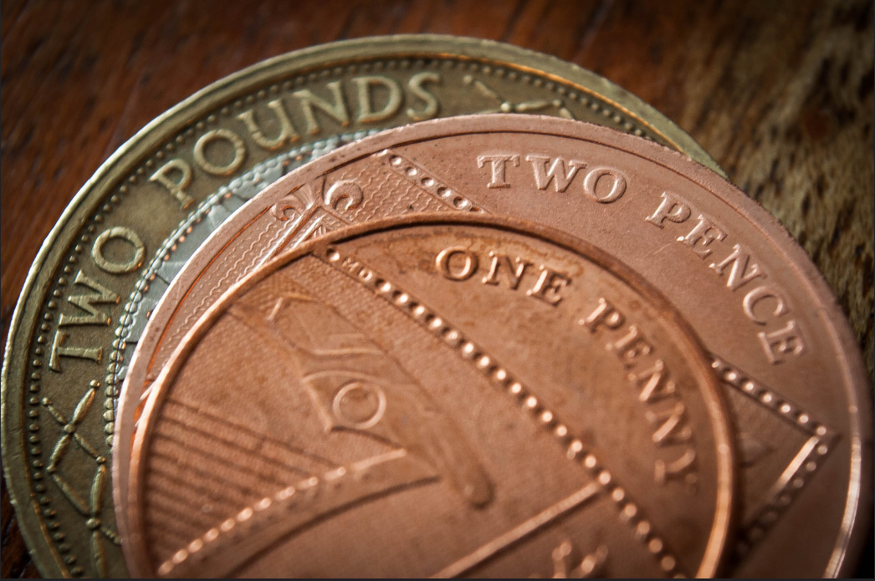
How might we use our money as an act of witness?
Photo credit: Mike Beales (Flikr, CC 2.0)

Slide 5
Bank accounts
Photo credit: fsecart (Flikr, CC 2.0)
Notes:
The banking system
Banks pool the money we deposit with them to make loans or invest in financial markets. Bank accounts may include current accounts (to make managing your money easier on a day-to-day basis) and savings accounts (in which you gain interest while leaving your money untouched for a longer period of time).
The practice of lending at interest – sometimes called usury – is at the heart of the modern banking system. It has been condemned by Jews, Christians and Muslims for most of their history. Is all lending at interest wrong? Or only if it’s at excessive rates and, if so, what is excessive?
For many people, the main ethical question about bank accounts is what the bank will do with your money. Individuals don’t have a choice about how their deposits are used and therefore, depending on the bank’s ethical policy, could be used to buy unsustainable and unethical investments. You may want it not to fund industries to which you object (for example, arms or fossil fuels) or you may want it to be more pro-active and fund industries that you would like to see supported (such as renewable energy or social housing). You may have concerns about usury, or the bank’s ethics in other areas, such as workers’ conditions or pay ratios.
It can be useful to check the details of your banks’ ethical policy to see how closely the it matches your own values. For some useful information on the ethics of many of the large banks, visit www.moveyourmoney.org.uk/institution-types/ethical-banks/.

Slide 6
Ludlow
Credit unions and building societies
Photo credit: Ludlow Quaker meeting
Notes:
Credit unions
This picture shows members of Ludlow meeting opening up accounts at their local credit union.
Credit unions are mutual (co-operative) organisations which offer savings accounts, affordable loans to their members and, depending on the credit union, other financial services such as current accounts. Members decide how the credit union is to be run, and elect a board and management team to run the credit union in their shared interests. Credit unions usually require members to have a “common bond”, which is usually a shared geographic location, but can also be membership of a profession, club, or association.
One way of challenging the financial exclusion experienced by many in our communities is through supporting the development and sustainability of credit unions, as they commonly deal in smaller loans than banks, tend to have lower rates of interest and operate for the mutual benefit of their members.
Building societies
Building societies have a similar structure to credit unions, but don’t necessarily have a stated common bond. They were originally designed to help their members to buy houses, although they now make loans for a much wider range of purposes. Several of the larger building societies also offer current accounts.

Slide 7
Quaker Social Housing Account
Photo credit: Quaker Housing Trust
Notes:
Quaker Social Housing Account
The Quaker Housing Trust is the Yearly Meeting’s own housing charity.
It was created by Friends as a channel to turn their concern and money into practical help for people in need of housing. QHT does this through advice, grants and interest free loans to social housing projects. These in turn transform people’s lives by giving them a safe place in which to live.
You can open a savings account with Triodos bank called the Quaker Social Housing Saver, where your savings will be put to work supporting QHT to lift the burden of homelessness and inadequate housing.
QHT was set up to be the national channel through which Friends can directly give financial support for social housing projects, and therefore do not receive any central funding from Britain Yearly Meeting. They welcome donations from individuals and meetings, as well as the donation of legacies. You can find out more at www.qht.org.uk.
You can also support local social housing projects by bringing them to the attention of QHT as the project may be eligible for QHT help.

Slide 8
Shares (equities)
Shares
Photo credit: Ken Teegardin (Flikr, CC 2.0)
Notes:
Shares
This is a common form of investment for individuals and meetings. Some investors choose to manage their shareholdings directly, whilst others choose to use a professional investment management company.
As a shareholder you are a ‘member’ or part owner of a company. It means that if things go well you do well, but if things don’t you could well lose your cash.
BYM has around £20 million invested in the stock market. Collectively, the UK Churches have over £15 billion.
While you might not have shares yourself, if you have a pension the chances are that you will have some indirectly. Organisations that you are associated with (e.g. charities or trade unions) may also have shareholdings.
As a shareholder you have certain rights – such as the right to information about the company, the right to attend the company annual general meeting (AGM) and question the directors. Shareholders can decide whether to buy or sell a company’s shares, as well as being able to choose how to vote at an AGM on issues ranging from executive pay to environmental policy. Consequently, those who own large numbers of shares can have considerable influence.
For shareholders who want to invest ethically, there are three common approaches: negative screening, positive screening and engagement.

Slide 9
Positive/negative screening
Photo credit: Alan Allport
Notes:
Negative screening
This means not putting your money into industry sectors or companies with which you disagree. Some of those most commonly screened for include: arms, fossil fuels, alcohol and tobacco, gambling, pornography, abortion and euthanasia, animal testing.
Divestment (also called disinvestment) is the practice of giving up or selling shares. This is often a difficult decision. On the one hand, you will lose the chance to use your position as a shareholder to influence the company. On the other hand, your divestment may affect the company’s reputation or put more pressure on the company to change - especially if you do a good job of publicising your decision.
Positive screening
Many ethical investors buy shares in industries and sectors they see as beneficial as a whole, such as renewable energy, recycling, environmental technology, public transport or social housing.
Others select and invest in companies they believe to be more ethical than other companies within the same sector, for example for companies that have especially good policy and practice in terms of working conditions, equal opportunities, energy efficiency, recycling, or support for Fairtrade or community projects.

Slide 10
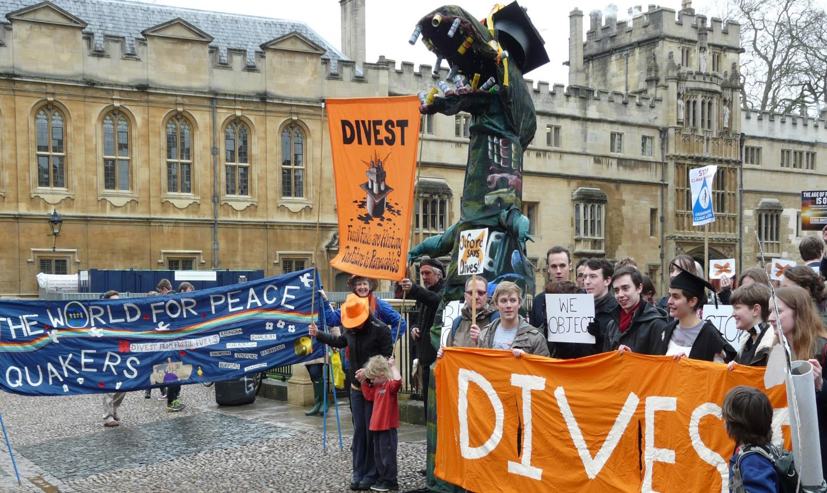
Britain Yearly Meeting divestment
Photo credit: Alan Allport
Notes:
BYM’s divestment from fossil fuel extraction is a good example of both negative and positive screening.
In the Autumn of 2013 BYM sold its shares in Statoil and BG Group. These represented around 2% of a portfolio of about £21m. The funds released from the sale of these shares, and more, was used to invest in renewable energy. This process involved negative screening, through avoiding something we see as harmful (fossil fuel extraction), as well as positive screening, through actively looking for investment opportunities in something we see as beneficial (renewables).
Increasing numbers of Local and Area Quaker Meetings and Quaker organisations are divesting their funds from fossil fuels.

Slide 11
Engagement
Image credit: Interfaith Center on Corporate Responsibility
Notes:
Engagement
Engagement involves using the leverage that being a shareholder offers to try and to improve company policy and practice. It is also referred to as shareholder activism, and can involve groups that either happen to already own shares in a company or who deliberately buy shares in order to engage with the board or staff to seek changes of policy on ethical grounds.
A group or individual who object to a company’s core activity may even buy single shares in order to attend the AGM so that they can stage a protest or ask probing questions that may be reported in the media.
In the run up to the London 2012 Olympics, QPSW was involved with an international coalition of investors to get hotel companies operating in London to take action to prevent instances of human trafficking and worker exploitation occurring on their premises (see image). Hotels often rely on agency workers for many back of house roles. Workers are often migrants. Pay is low and sometimes piece rate – which means that workers are vulnerable to exploitation. At the same time there was a fear that there might have been an increase in sex trafficking over the Olympic period. The coalition, which between it owned assets of over $58 billion, sent letters and set up meetings with the companies. Two of the UK’s largest hotel groups, which had previously been reluctant, adopted policies on these issues and trained staff to prevent/respond to situations occurring on their premises.

Slide 12
More engagement
Photo credit: Campaign Against Arms Trade
Notes:
In 2007, the Joseph Rowntree Charitable Trust (JRCT) sold nearly £2,000,000 worth of shares in the publishing company Reed Elsevier (http://www.caat.org.uk/press/press-release.php?url=130207prs). The decision followed a long period of critical engagement during which JRCT sought to persuade Reed to end its subsidiary business running arms fairs. The divestment added to the pressure brought by the Campaign Against Arms Trade and negative media coverage. Four months later, Reed announced its decision to sell the arms fairs (http://www.caat.org.uk/press/press-release.php?url=040607prs).
Rathbone Greenbank, the current BYM Fund Managers were involved in the dialogue too, although they weren’t BYM fund managers at the time.

Slide 13
More engagement
Photo credit: Share Action
Notes:
Increasingly, there are opportunities for individuals and smaller institutions who own shares to take part in coordinated engagement. For example, the Ecumenical Council for Corporate Responsibility often coordinates actions that individuals can take part in as well as institutions, and Share Action provides tools for individuals to lobby their pension funds to take a more ethical approach.
This photo shows a member of Share Action’s AGM Army asking Shell questions about why it was member of lobby groups that had lobbied against progressive policies in renewable energy, despite the fact that it publically claimed that it was in favour of renewable energy.
Juliet Phillip, Campaigns Officer of ShareAction describes some of the events at Shell’s 2015 AGM in her blog at https://shareaction.org/live-today-at-the-circustheater-the-shell-show/

Slide 14
Property/buildings
Photo credit: Quaker Peace & Social Witness
Notes:
Property/ buildings
For many meetings their largest asset will be their Meeting House; so the way this is used can have a significant impact.
Many meetings offer low cost meeting space for groups that could not afford it otherwise. Friends House does this for partnership groups – for example, the gifting of space for an Occupy London meeting shown in this picture.
Individuals might invest in property/buildings too, either through individual investment or through a pooled fund.
This can have positive impacts, through the individual or group being a good landlord, and actively meeting social and community needs.
Yet it can also push up the price of houses through speculation, and perhaps creates inappropriate development if ill-thought through.

Slide 15
Property/buildings
Photo credit: Central England Area Meeting
Notes:
Prompted by local redevelopment, Central England Area Meeting decided to forgo rental income and instead convert space that was previously used by commercial tenant into a community facility for peace and justice work.
The Peace Hub in central Birmingham aims to be a centre from which a diverse community in Central England is inspired to act for peace and justice.

Slide 16
Social impact investment
Photo credit: Abolish Empty Office Buildings, House People
Notes:
Social impact investment, or “positive impact”/ “mission-related” investment
“Mission-related” or “impact” investment, takes positive screening a step further. Social Impact investment is used to describe an investment that is made as much to promote a particular scheme or practice as it is for the sake of making money. Supporters of this approach insist that the two aims need not be in tension.
Examples include community land and reinvestment trusts, ecological building projects, organic food and Fairtrade initiatives, and microcredit-based social development programmes.
These initiatives, as many are keen to point out, are not acts of charity. Although with some initiatives, their rate of return may not be as high as more conventional investments.
It may also be riskier or harder to sell your shares as they are usually not listed on a stock market. However, organizations such as Ethex (see further information slide) are trying to make this easier.
This photo is from a Quaker supported project in Bristol, called “Abolish Empty Office Buildings, House People”. It was financed through Triodos bank and a community share issue which has already raised almost £300,000.

Slide 17
Faith and Finance: practical questions
What are your key values/concerns?
What are your financial objectives?
Might you need to access your money quickly?
Do you need professional advice?
Are there legal constraints (for trustees)?
Notes:
Faith & Finance: practical questions
With all of these options, how do you decide what’s the right thing to do with your money?
There is no single right answer and, of course, practically some of us may have more options than others. Nevertheless here are some practical questions to get you thinking about what’s important to your situation, as an individual or a meeting.
You should also seek professional advice, especially if your investments are in any way complex. There are a number of advisors specialising in ethical investments.
For Quaker meetings (or other groups) there are also legal issues to consider. Many group’s investments are overseen by committees or trustees who have a fiduciary responsibility to ensure that the investments are used in the best interest of the group. The UK authorities now explicitly recognise that charities and faith groups must be allowed to invest according to their values. Failure to do so could actually undermine those groups. That doesn’t mean that the trustees can do as they like, but it does mean that they can take a much more rounded approach to what can be described as the group’s ‘best interests’.

Slide 18
Other sources of information
Your Ethical Money www.yourethicalmoney.org
Good Money Week www.goodmoneyweek.com
Ethical Investment Association www.ethicalinvestment.org.uk
Share Action www.shareaction.org
Association of British Credit Unions ltd. www.abcul.org
Scottish League of Credit Unions www.scottishcu.org
Ethical Consumer www.ethicalconsumer.org
Ethex (positive investment) www.ethex.org.uk
Ecumenical Council for Corporate Responsibility www.eccr.org.uk
Notes:
Summing up and reflections from the facilitator
What are the key conclusions from the workshop? Will you all meet again? Are there any next steps you want to raise?
Remind people that there’s much more information about all of this on the Your faith, your finance website (slide 18) and from the websites here.
See page 17 in the accompanying resources booklet for more information on each of these organisations.

Slide 19
www.yourfaithyourfinance.org
A guide to money, faith and ethics
Contact suzannei@quaker.org.uk or 0207 663 1055 for more information.
A workshop from Quaker Peace & Social Witness

Slide 20
Faith and Finance
“We believe that, as Quakers, we should put our whole lives under the guidance of the Spirit. This should determine our choices as individuals and as a Society between saving and spending and the way in which savings are invested. We are led to choose investments that benefit the community at large and not just ourselves and our families or small groups; to be strictly honest and truthful; and to refuse to deal in products or services which are hurtful to individuals or to society as a whole. We should only invest in accordance with our principles.”
Young Friends Central Committee 1980
Quaker Faith & Practice 20.57
Notes:
Close
You may want to read out a final quote for reflection, or end with worship.

